Slide 1

CONTAINERS
Abel Sanchez, John Williams

Slide 2
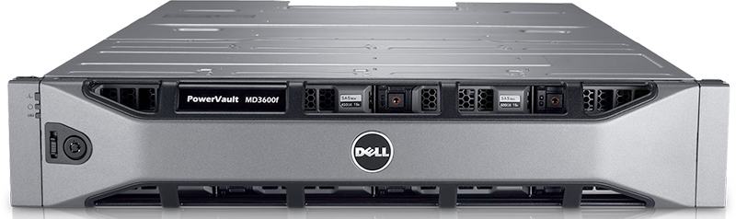
Setting Up a Machine is Hard Work

Slide 3










Installation, setup, configuration, admin
APP SERVERS
Installation, setup, configuration, admin
DATA STORE
runtimes, languages, packages, configurations
DEPENDENCIES
PATCHING
OS
COMPUTER

Slide 4


Slide 5
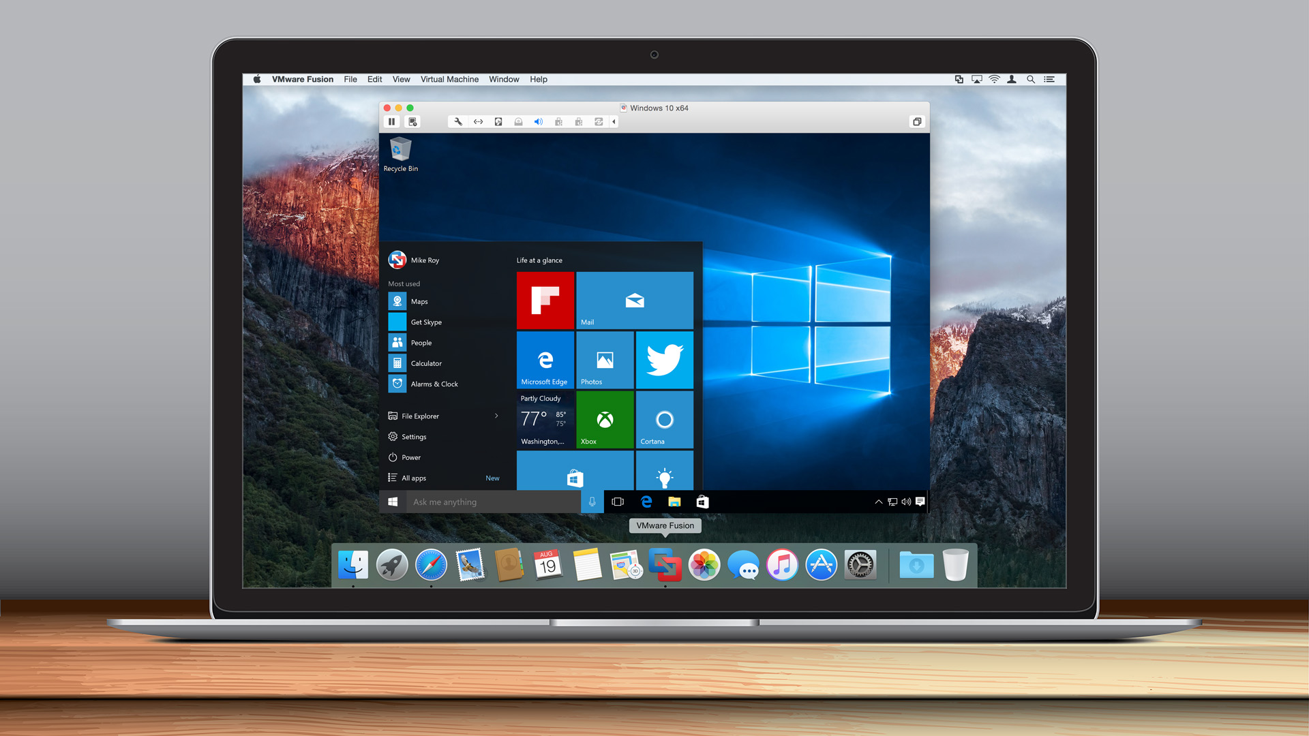
VM
VM

Slide 6


Installation, setup, configuration, admin
APP SERVERS
Installation, setup, configuration, admin
DATA STORE
runtimes, languages, packages, configurations
DEPENDENCIES
PATCHING
OS
VM SOFTWARE
vm fusion
virtual box

Slide 7
Docker, Why Do We Care?
https://www.youtube.com/watch?v=El_XpG4haz0

Slide 8
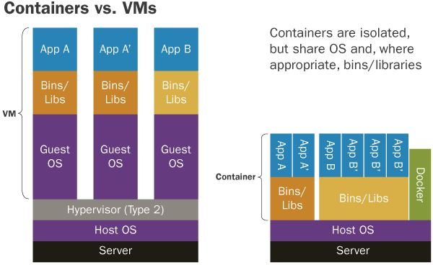
Container vs. VM

Slide 9
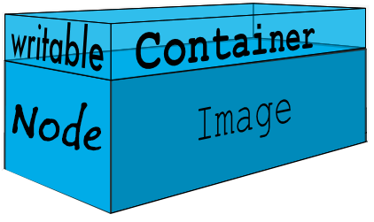
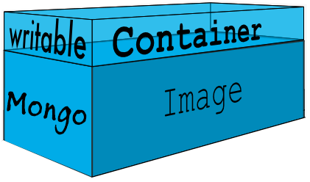
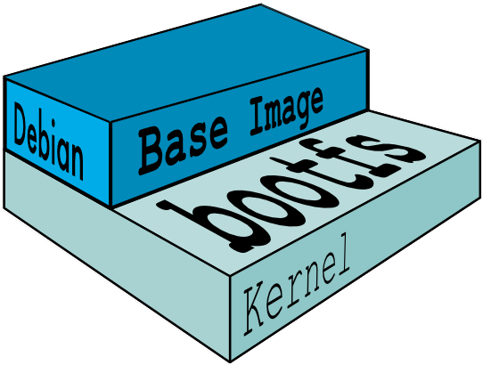
Docker Images
Base Image
Base Image
Plus
Node
Base Image
Plus
Mongo

Slide 10
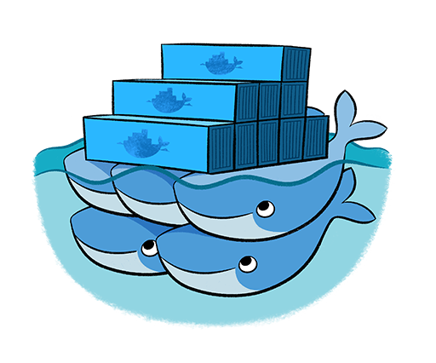
Registry of Images

Slide 11
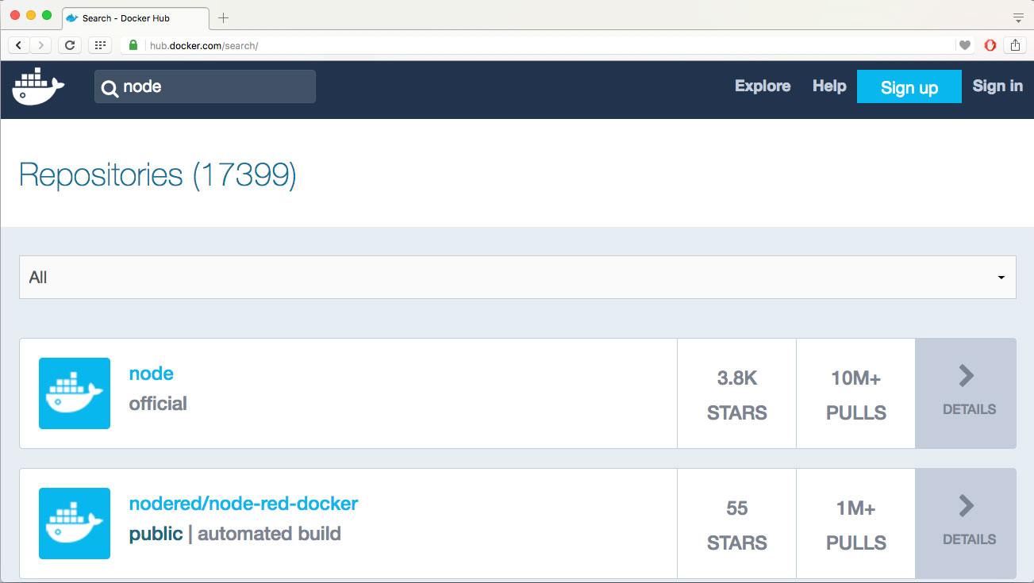

Slide 12
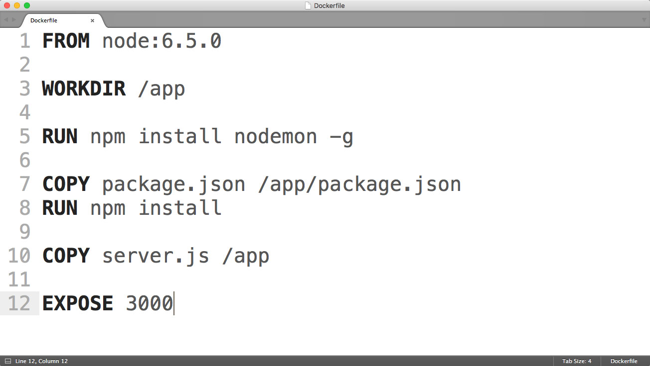

Slide 13
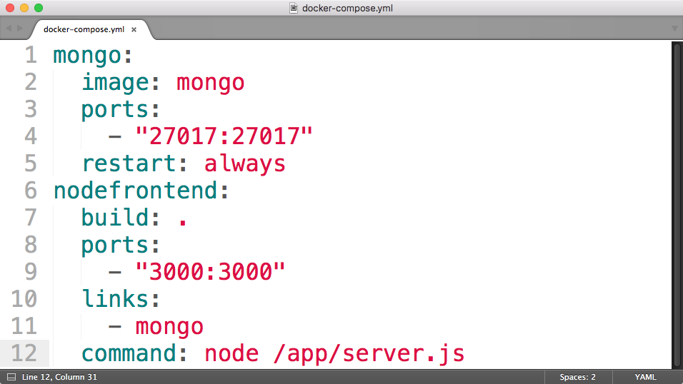

Slide 14

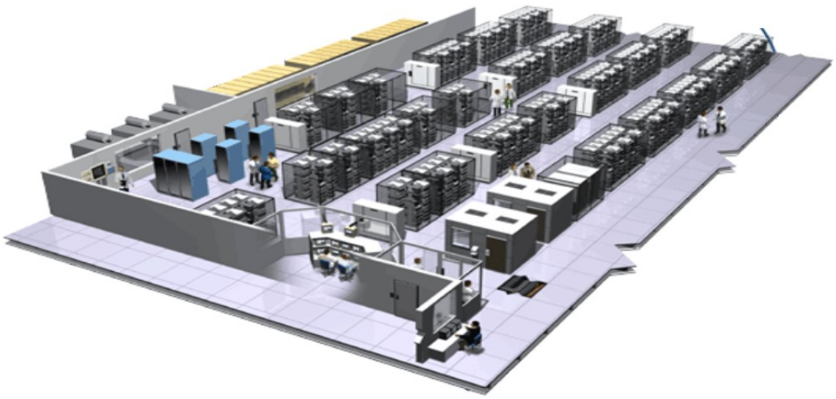
Every Week: 2 Billion Containers
(internally)

Slide 15
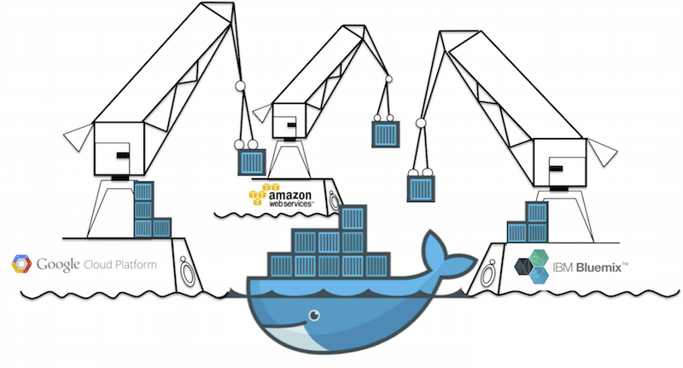

Slide 16
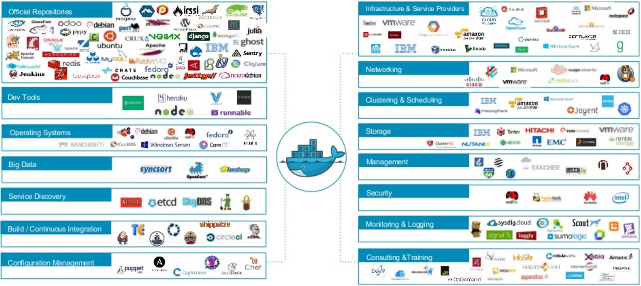
Docker Ecosystem

Slide 17
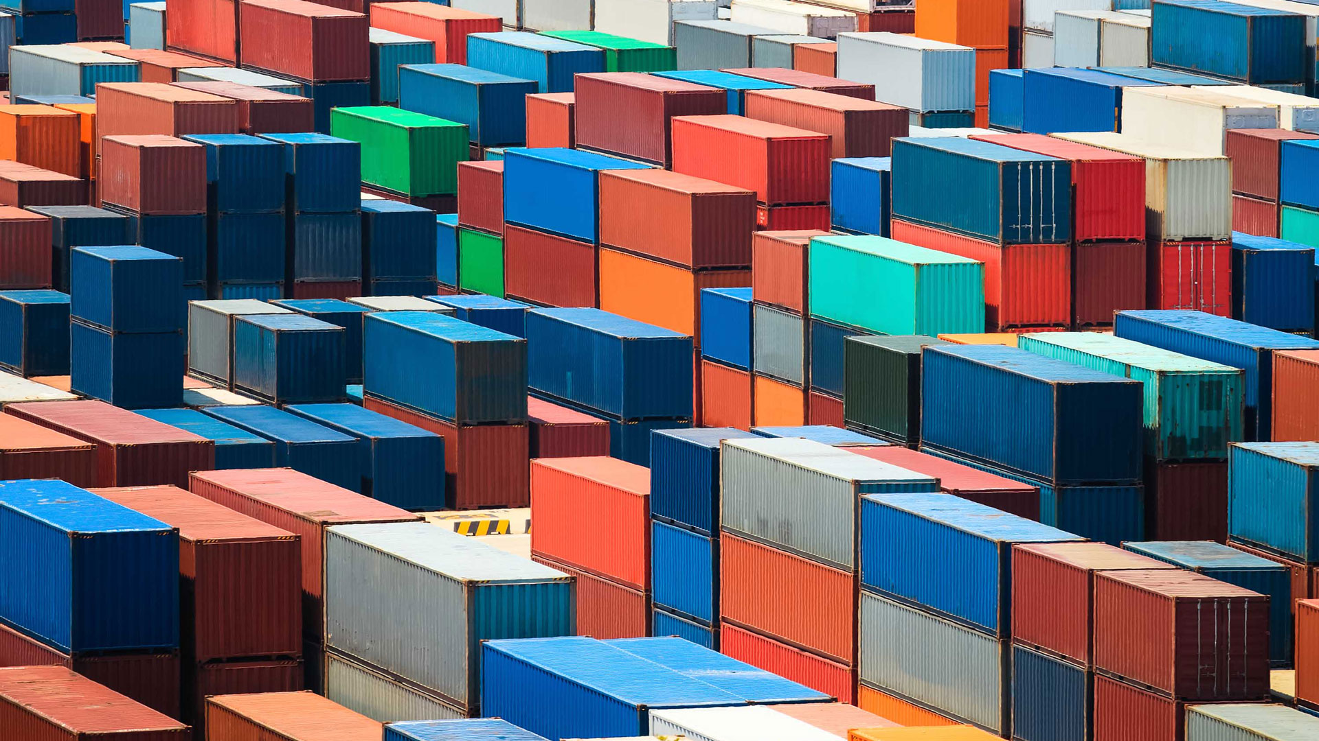
Active Learning

Slide 18
Install Docker
https://www.docker.com

Slide 19
Storage
The JS stack story vs enterprise computing
Slides at
http://onexi.org/abel/19_data_stores/slides.html

Slide 20
Docker Exercise #1
al-mongo
Node application plus dockerized mongo database
https://github.com/onexi/ex-mongo
Steps
$ docker-compose up
$ npm install

Slide 21
Docker Exercise #2
al-mongonode
Dockerized node application plus mongo database
https://github.com/onexi/ex-mongonode
Steps
$ docker-compose up

Slide 22
Docker Exercise #3
al-mongoflask
Dockerized python, flask application, plus mongo database
https://github.com/onexi/ex-mongoflask

Slide 23
Deleting Containers/Images
Deleting containers
$ docker rm $(docker ps -aq)
Deleting images
$ docker rmi $(docker images -q)

Slide 24

Docker
Project
Abel Sanchez and John R Williams

Slide 25
Project
UPDATE
Phase
0, Due Thursday, Nov 3rd, 2016
1, Due: Thursday, Nov 10th, 2016
2, Due: Thursday, Nov 17th, 2016
3, Due: Thursday, Dec 1st, 2016
All submissions will be made on Github
Fork, clone, add your files, push, pull request
Note: your project will be public!

Slide 26
Repos
UPDATE
Deliverable #0, Due Thursday, Nov 3rd, 2016
https://github.com/1125f16/project-00
Deliverable #1, Due: Thursday, Nov 10th, 2016
https://github.com/1125f16/project-01
Deliverable #2, Due: Thursday, Nov 17th, 2016
https://github.com/1125f16/project-02
Deliverable #3, Due: Thursday, Dec 1st, 2016
https://github.com/1125f16/project-03

Slide 27
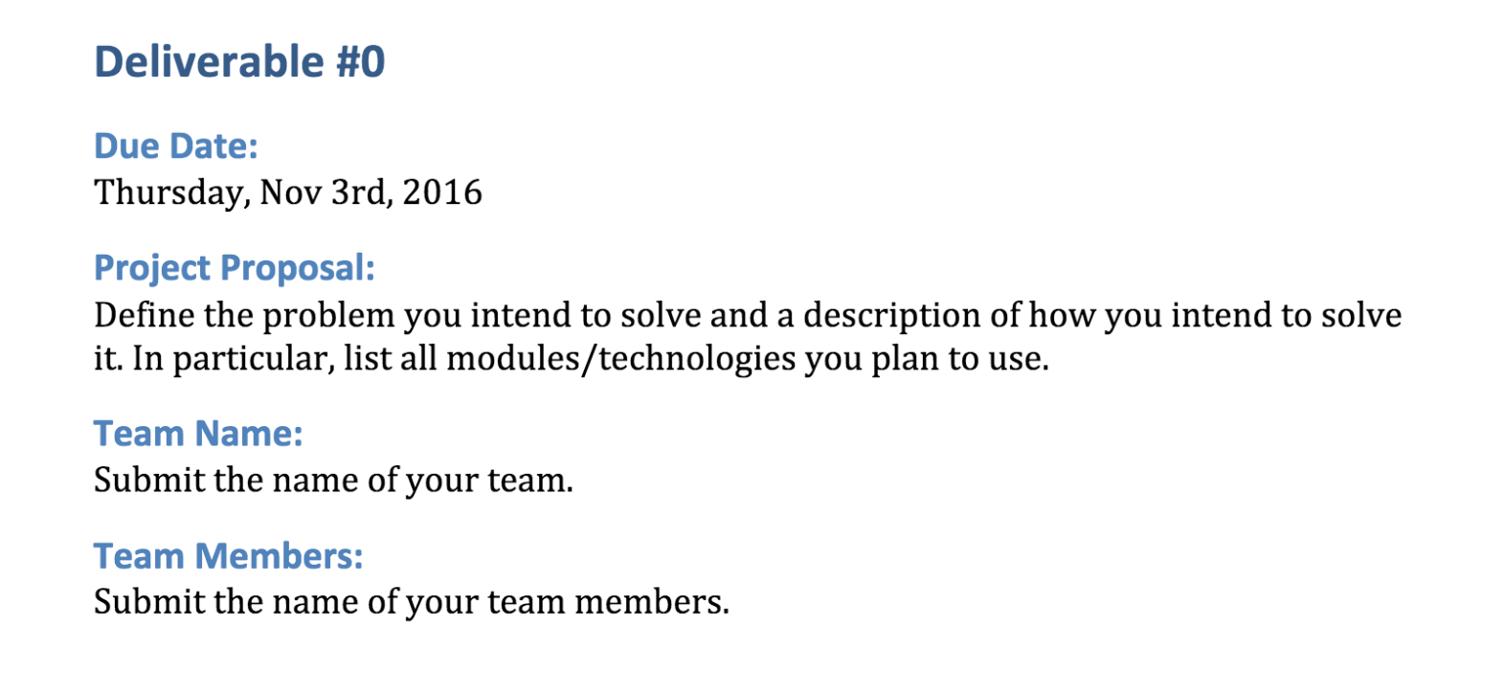
Due Next Thursday
UPDATE

